Slide 1
CS 414 - Object-Oriented Design Fall 2020
P2

Slide 2
P2 Objectives (for reference only - remove before presenting)
User stories and tasks /1.5
Kanban board /1.0
Design artifacts /1.5
Source code /3.0
Development manual /1.0
Traceability link matrix /1.0
Output of scrum ceremonies /1.0
Presentation /3.0
Peer evaluation /2.0

Slide 3
Meet the Team!
Unspecified Behavior
Adam Anderson
Brent Staab
Keabeth Gonzales
Kai Griem
Maddie Mihevc (Scrum Master)

Slide 4
Retrospective
During our last sprint we did a good job making sure to consistently meet with each other even just to check in each week even if we did not have much to talk about. We also did a good job of reaching out to each other when we got stuck on something instead of working on the same issue for several days.
What we needed to work better on was making sure we did not procrastinate and save anything till the last minute along with making sure that we followed the development process. Our last sprint we were more afraid to ask questions, but this sprint we made sure that it was a priority in order to make sure that we have a complete understanding.
This sprint we made sure we did not procrastinate as much as we did the first sprint. However even with starting our tasks earlier this time we still struggled on occasion to find the motivation as a team to work hard. The one thing that kept us going was making sure we consistently met each week so we can check in with each and see how much progress we have made.

Slide 5
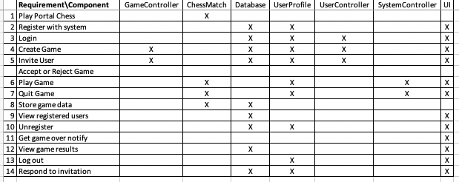
Traceability Link Matrix

Slide 6
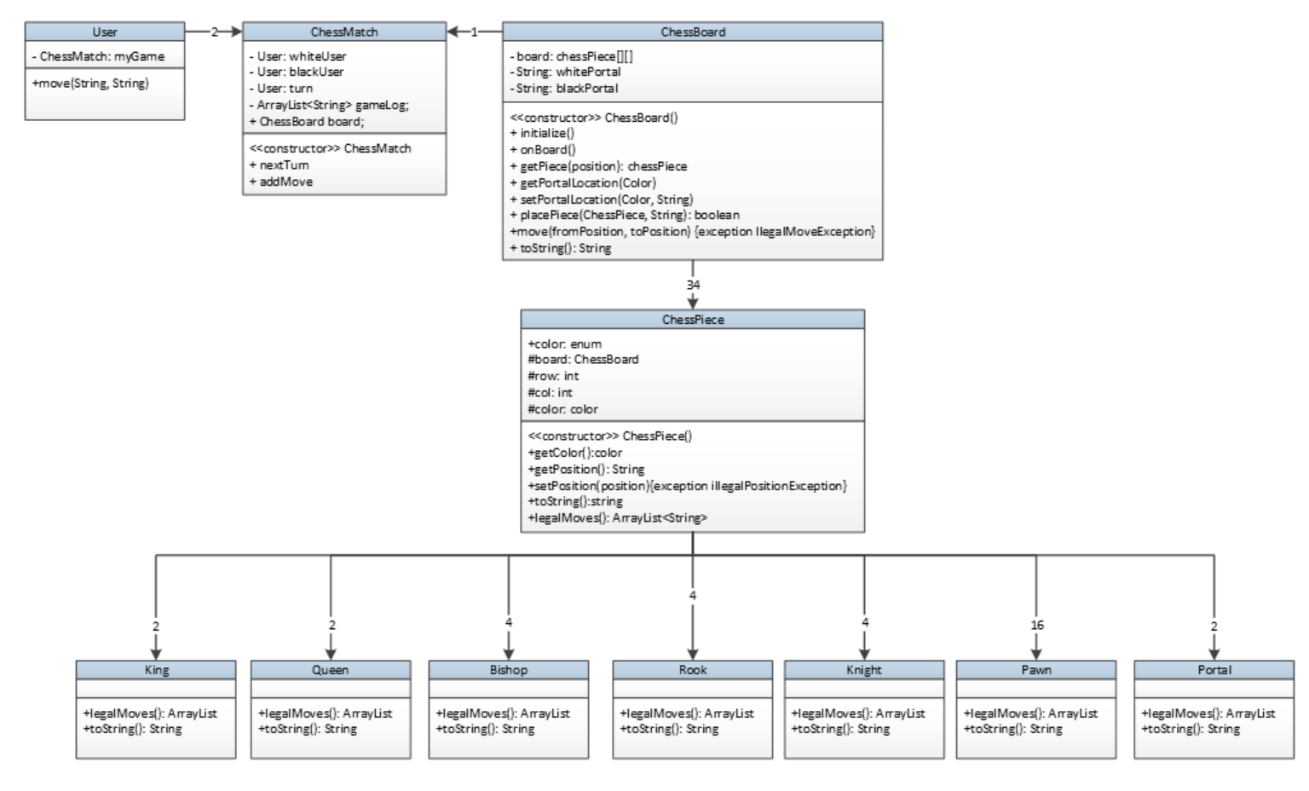
Class Diagram

Slide 7
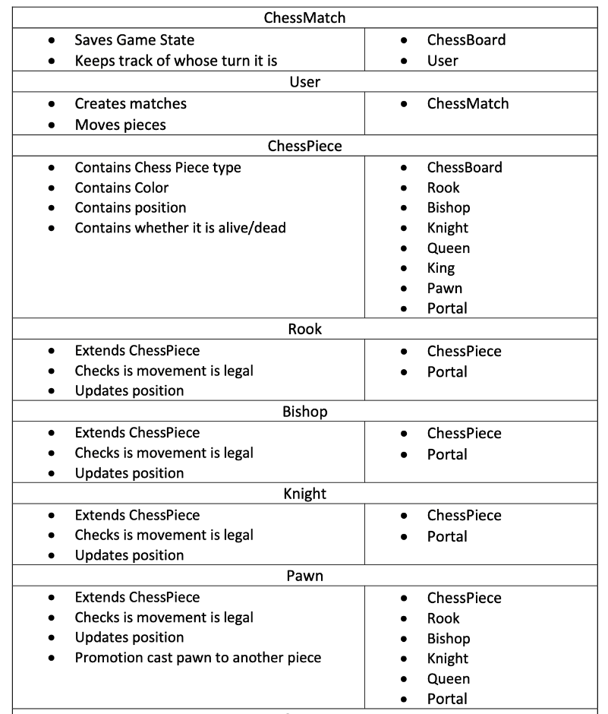
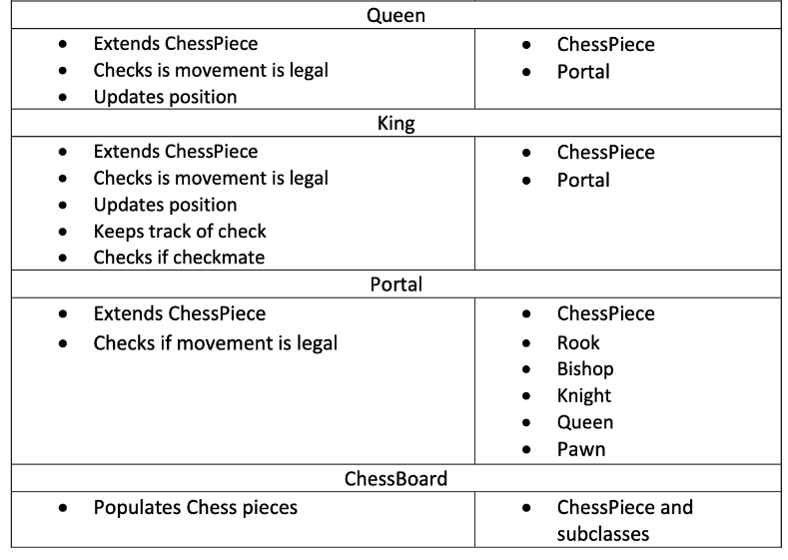
CRC Cards

Slide 8
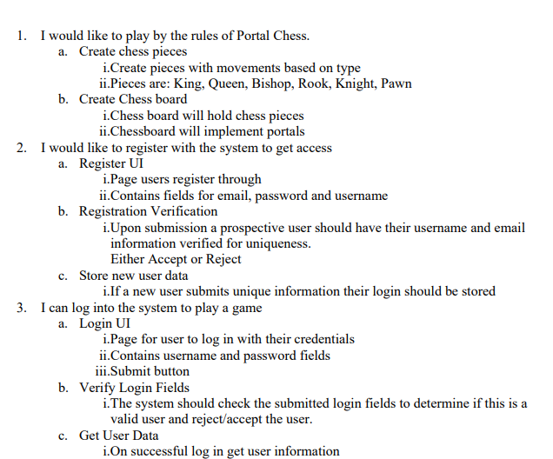
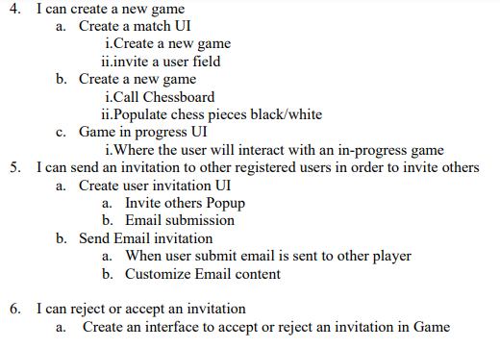
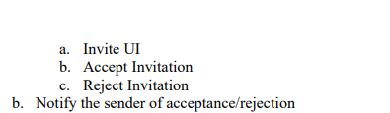
User Stories and Tasks

Slide 9
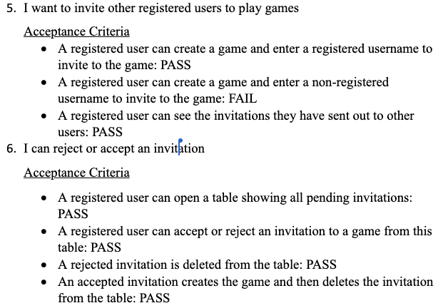
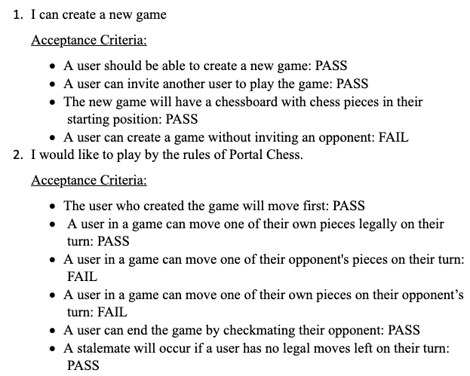
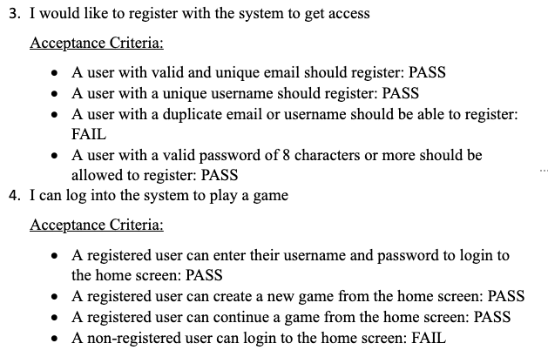
Acceptance Criteria

Slide 10
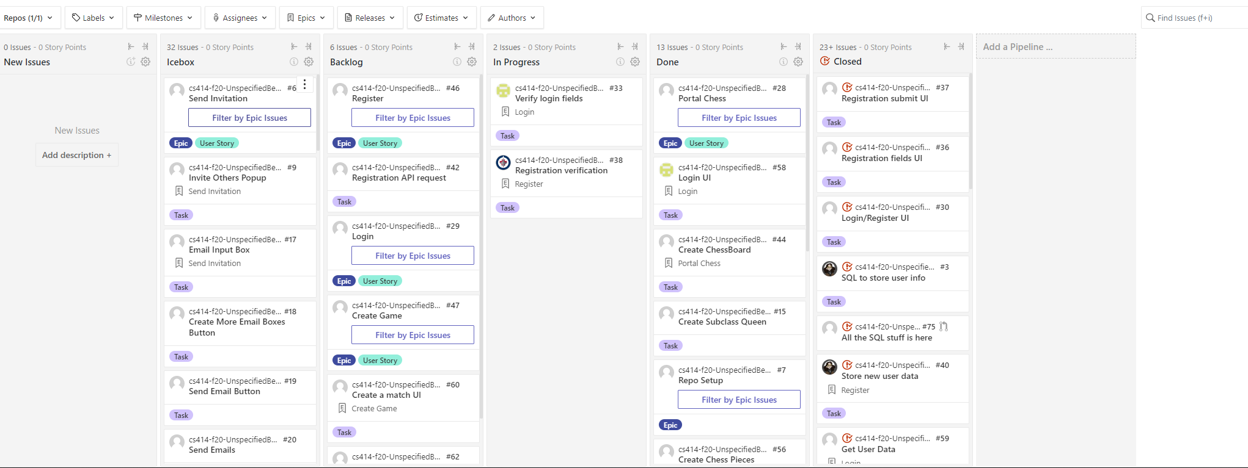
Kanban Board

Slide 11
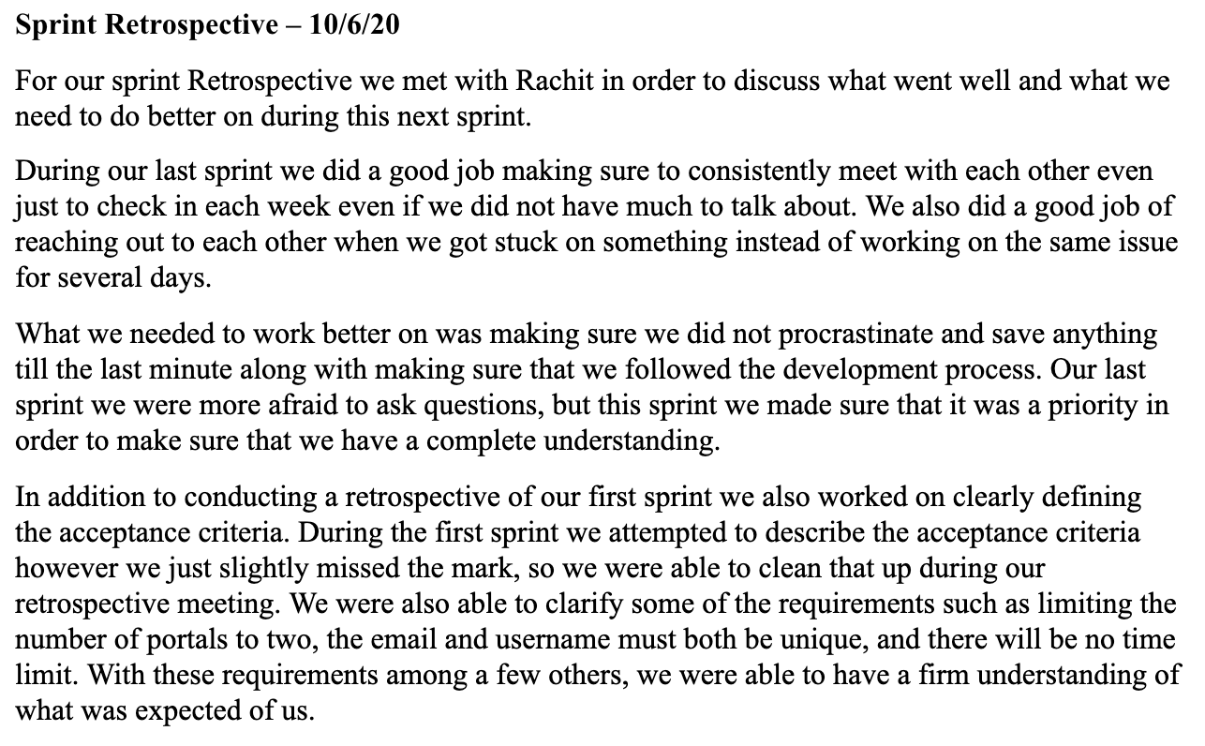
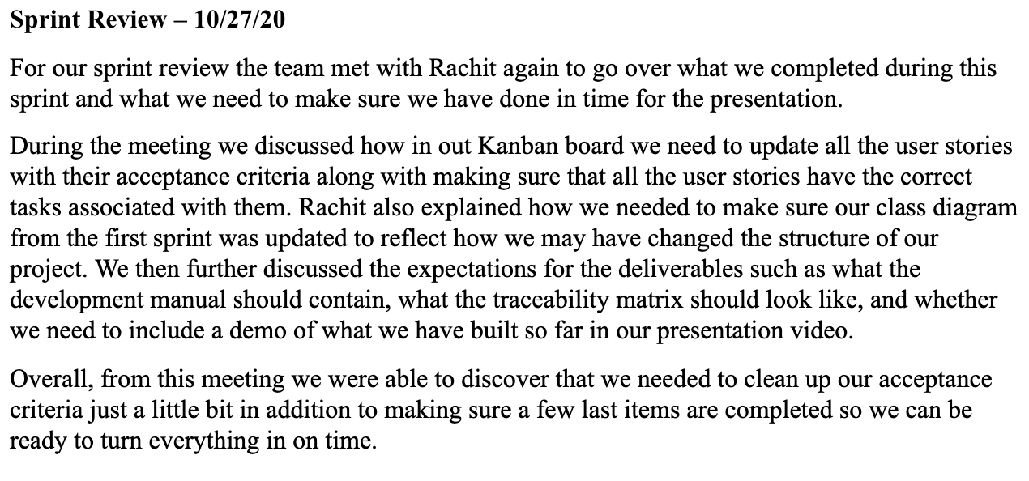
Output of Scrum Ceremonies

Slide 13
Rules
There are several types of Portal chess, but we are planning on implementing the version described by wika57 on his YouTube video. https://www.youtube.com/watch?v=Zq4pJw_nk_0
Setup
The basic rules of classical chess apply
Pieces have the same restrictions, and the overall objective is the same (checkmate the King)
Players place their portals before the game starts
White pieces can only go in row 4
Black pieces can only go in row 5
You can only control your own colored portal

Slide 14
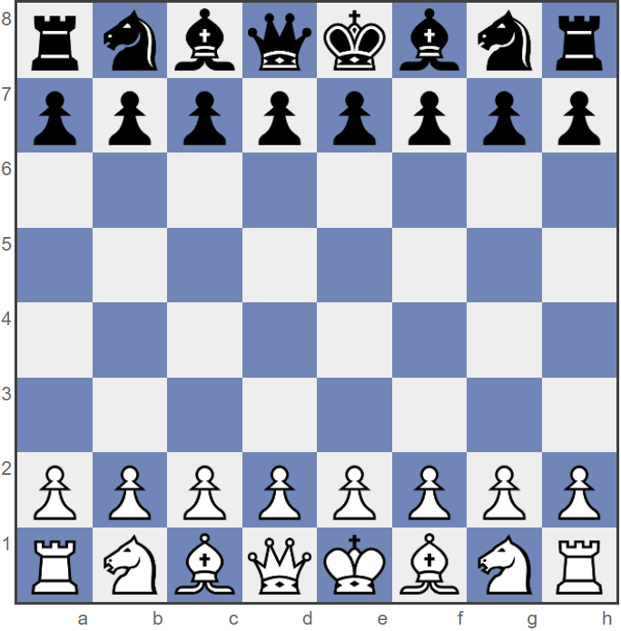
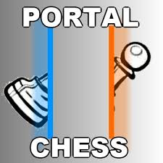
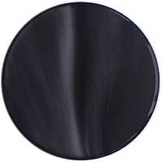



Description of Portal Chess
Portal chess is a derivative of the classical chess game. The main difference is the introduction of two new ‘fairy pieces’ called portals which allow the pieces to move in new and exciting ways.
Image from: https://images.app.goo.gl/dHWwR21iMgRP1wJz5

Slide 15
Rules - continued
Game Play
A piece passes through a portal unless the portal is blocked
A piece can be blocked from entering a portal if a piece of the same color is on the other side.
A piece can take another piece by using the portal
Both portals cannot be occupied at the same time
A piece can check/checkmate people using the portal
A piece must exit the portal in the direction it traveled into the portal
A portal can be moved onto a piece causing it to teleport. *Unless the other portal is occupied*
A player has a choice to move a chess piece or the portal piece in one turn, not both.
If your own chess piece is occupying a portal, you cannot pass another one of your own pieces through the unoccupied portal
A piece can enter either portal regardless of color
Portals can not occupy the same square
A portal can be moved regardless of whether it is occupied or not, the occupying piece does not move with the portal
If a piece occupies one portal and a whole turn phase end without the piece moving from the teleporter it does not teleport.
A Knight can jump over a portal piece
A pawn can become a queen by using a portal

